Slide 1

Introducing Bitcoin
UNIT-4

Slide 2
Introducing Bitcoin
Bitcoin is the first application of blockchain technology. In this chapter, you will be introduced to Bitcoin
technology in detail.
Bitcoin has started a revolution with the introduction of the very first fully decentralized digital currency, and
the one that has proven to be extremely secure and stable from a network and protocol point of view. As a
currency bitcoin is quite unstable and highly volatile, albeit valuable.

Slide 3
Bitcoin definition
Bitcoin can be defined in various ways; it's a protocol, a digital currency, and a platform. It is a combination of
peer-to-peer network, protocols, software that facilitate the creation and usage of the digital currency named
bitcoin. Nodes in this peer-to-peer network talk to each other using the Bitcoin protocol.

Slide 4
Bitcoin – a bird's-eye view
In this section, we will see how the Bitcoin network looks from a user's point of view. How a transaction is made, how it propagates from a user to the network, how transactions are verified, and finally, accumulated in blocks.
The main components of a Bitcoin network are:
Digital keys
Addresses
Transactions
Blockchain
Miners
The Bitcoin network
Wallets (client software)

Slide 5
Sending a payment to someone
This example demonstrates how money can be sent over the Bitcoin network from one user to another.
There are several steps that are involved in this process. For example, we are using a mobile Blockchain wallet.
The steps are described here:
1. First, either the payment is requested from a user by sending their Bitcoin address to the sender via email or some other means, such as SMS, chat applications, or, in fact, any appropriate communication mechanism. The sender can also initiate a transfer to send money to another user. In both cases, the address of the beneficiary is required.

Slide 6
2. The sender either enters the receiver's address or scans the QR code that has the Bitcoin address, amount and optional description encoded in it. The wallet application recognizes this QR code and decodes it .
3. This will look like as shown here with values: Please send 0.00033324 BTC to the Bitcoin address 1JzouJCVmMQBmTcd8K4Y5BP36gEFNn1ZJ3.
4. This is also shown in the screenshot presented here:

Slide 7
5. In the wallet application of the sender, this transaction is constructed by following some rules and broadcast to the Bitcoin network. This transaction is digitally signed with the sender's private key before being broadcast.
Fields such as From, To, BTC, and Fee. While other fields are self-explanatory, it's worth noting that the fee is calculated based on the size of the transaction, and the fee rate is a value that depends on the volume of the transaction in the network. This is represented in Satoshis/byte. Fee in the Bitcoin network ensures that your transaction will be included by miners in the block.

Slide 8
Once the transaction is sent, it will appear as shown here in the Blockchain wallet software:
4. At this stage, the transaction has been constructed, signed and sent out to the Bitcoin network. This
transaction will be picked up by miners to be verified and included in the block.

Slide 9
Digital keys and addresses
On the Bitcoin network, possession of bitcoins and transfer of value via transactions is reliant upon private keys, public keys, and addresses.
Private keys in Bitcoin
Private keys must be kept safe and typically reside only on the owner's side. Private keys are used to digitally sign the transactions, proving the ownership of the bitcoins.
Private keys are fundamentally 256-bit numbers randomly chosen in the range specified by the secp256k1 ECDSA curve recommendation.
Any randomly chosen 256-bit number from 0x1 to 0xFFFF FFFF FFFF FFFF FFFF FFFF FFFF FFFE BAAE DCE6 AF48 A03B BFD2 5E8C D036 4140 is a valid private key.

Slide 10
Public keys in Bitcoin
Public keys exist on the blockchain, and all network participants can see them. Public keys are derived from private keys due to their special mathematical relationship with the private keys. Once a transaction signed with the private key is broadcasted on the Bitcoin network, public keys are used by the nodes to verify that the transaction has indeed been signed with the corresponding private key. This process of verification proves the ownership of the Bitcoin.
A public key is 256-bits in length. Public keys can be represented in an uncompressed or compressed format.

Slide 11
Addresses in Bitcoin
A bitcoin address is created by taking the corresponding public key of a private key and hashing it twice, first with the SHA-256 algorithm and then with RIPEMD-160. The resultant 160-bit hash is then prefixed with a version number and finally encoded with a Base58Check encoding scheme. The bitcoin addresses are 26-35
characters long and begin with digit 1 or 3. A typical bitcoin address looks like a string shown here: 1ANAguGG8bikEv2fYsTBnRUmx7QUcK58wt
Currently, there are two types of addresses, the commonly used P2PKH and another P2SH type, starting with number 1 and 3, respectively.

Slide 12
Base58Check encoding
Bitcoin addresses are encoded using the Base58Check encoding. This encoding is used to limit the confusion between various characters, such as 0OIl, as they can look the same in different fonts. The encoding basically takes the binary byte arrays and converts them into human-readable strings. This string is composed by utilizing a set of 58 alphanumeric symbols.

Slide 13
Transactions
Transactions are at the core of the bitcoin ecosystem. Transactions can be as simple as just sending some bitcoins to a bitcoin address, or it can be quite complex depending on the requirements. Each transaction is composed of at least one input and output. Inputs can be thought of as coins being spent that have been created in a previous transaction and outputs as coins being created.

Slide 14
The transaction life cycle
The following steps describe the transaction life cycle:
1. A user/sender sends a transaction using wallet software or some other interface.
2. The wallet software signs the transaction using the sender's private key.
3. The transaction is broadcast to the Bitcoin network using a flooding algorithm.
4. Mining nodes (miners) who are listening for the transactions verify and include this transaction in the next block to be mined. Just before the transaction is placed in the block, they are placed in a special memory buffer called the transaction pool. The purpose of the transaction pool is explained in the next section.
5. Mining starts, which is a process by which the blockchain is secured, and new coins are generated as a reward for the miners who spend appropriate computational resources. This concept is explained in more detail later in this chapter.
6. Once a miner solves the PoW problem, it broadcasts the newly mined block to the network. PoW is explained in detail later in this chapter.
7. The nodes verify the block and propagate the block further, and confirmations start to generate.
8. Finally, the confirmations start to appear in the receiver’s wallet, and after approximately three confirmations, the transaction is considered finalized and confirmed. However, three to six is just a recommended number; the transaction can be considered final even after the first confirmation. The key idea behind waiting for six confirmations is that the probability of double-spending is virtually eliminated after three confirmations.

Slide 15
Transaction fee
Transaction fees are charged by the miners. The fee charged is dependent upon the size and weight of the transaction. Transaction fees are calculated by subtracting the sum of the inputs and the sum of the outputs.
A simple formula can be used: fee = sum(inputs) - sum(outputs)
The fees are used as an incentive for miners to encourage them to include a user transaction in the block the miners are creating

Slide 16
Transaction pools
Also known as memory pools, these pools are basically created in local memory (computer RAM) by nodes in order to maintain a temporary list of transactions that are not yet confirmed in a block. Transactions are included in a block after verification, based on their priority.

Slide 17
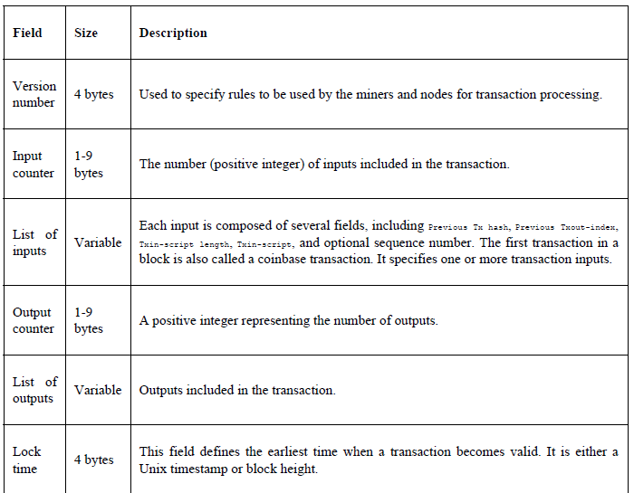
The transaction data structure
A transaction at a high level contains metadata, inputs, and outputs. Transactions are combined to create a block.

Slide 18
Types of transactions
There are various scripts available in Bitcoin to handle the value transfer from the source to the destination. These scripts range from very simple to quite complex, depending upon the requirements of the transaction.
The following are the standard transaction types:
Pay to Public Key Hash (P2PKH): P2PKH is the most commonly used transaction type and is used to send transactions to the Bitcoin addresses.
Pay to Script Hash (P2SH): P2SH is used in order to send transactions to a script hash (that is, the addresses starting with 3) and was standardized in BIP16. In addition to passing the script, the redeem script is also evaluated and must be valid.
MultiSig (Pay to MultiSig): M-of-N MultiSig transaction script is a complex type of script where it is possible to construct a script that requires multiple signatures to be valid in order to redeem a transaction. Various complex transactions, such as escrow and deposits, can be built using this script.
Pay to Pubkey: This script is a very simple script that is commonly used in Coinbase transactions. It is now obsolete and was used in an old version of Bitcoin.
Null data/OP_RETURN: This script is used to store arbitrary data on the blockchain for a fee. The limit of the message is 40 bytes.

Slide 19
Transaction verification
This verification process is performed by Bitcoin nodes. The following is described in the Bitcoin developer guide:
1. Check the syntax and ensure that the syntax and data structure of the transaction conform to the rules provided by the protocol.
2. Verify that no transaction inputs and outputs are empty.
3. Check whether the size in bytes is less than the maximum block size.
4. The output value must be in the allowed money range (0 to 21 million BTC).
5. All inputs must have a specified previous output, except for coinbase transactions, which should not be relayed.
6. Verify that n LockTime must not exceed 31 bits. (nLockTime specifies the time before which the transaction will not be included in the block.)
7. For a transaction to be valid, it should not be less than 100 bytes.
8. The number of signature operations in a standard transaction should be less than or not more than two

Slide 20
9. Reject nonstandard transactions; for example, ScriptSig is allowed to only push numbers on the stack. ScriptPubkey not passing the isStandard() checks. The isStandard() checks specify that only standard transactions are allowed.
10. A transaction is rejected if there is already a matching transaction in the pool or in a block in the main branch.
11. The transaction will be rejected if the referenced output for each input exists in any other transaction in the pool.
12. For each input, there must exist a referenced output unspent transaction.
13. For each input, if the referenced output transaction is the coinbase, it must have at least 100 confirmations. Otherwise, the transaction will be rejected.
14. For each input, if the referenced output does not exist or has already been spent, the transaction will be rejected.
15. Using the referenced output transactions to get input values, verify that each input value, as well as the sum, is in the allowed range of 0-21 million BTC. Reject the transaction if the sum of input values is less than the sum of output values.
16. Reject the transaction if the transaction fee would be too low to get into an empty block.
17. Each input unlocking script must have corresponding valid output scripts.

Slide 21
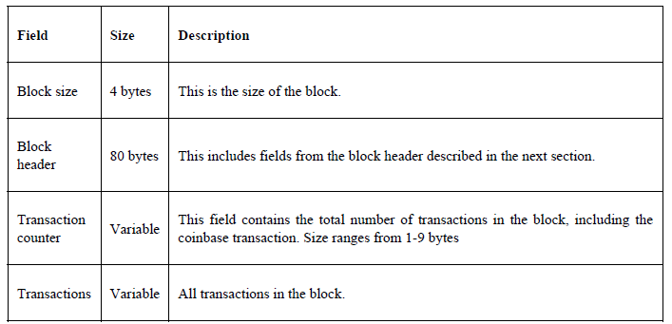
The structure of a block

Slide 22
Mining
Mining is a process by which new blocks are added to the blockchain. Blocks contain transactions that are validated by mining nodes on the Bitcoin network. Blocks, once mined and verified, are added to the blockchain, which keeps the blockchain growing. This process is resource-intensive due to the requirements of PoW, where miners compete in order to find a number that is less than the difficulty target of the network.

Slide 23
Tasks of the miners
Once a node connects to the Bitcoin network, there are several tasks that a Bitcoin miner performs:
1. Syncing up with the network: Once a new node joins the Bitcoin network, it downloads the blockchain by requesting historical blocks from other nodes. This is mentioned here in the context of the bitcoin miner; however, this not necessarily a task only for a miner.
2. Transaction validation: Transactions broadcast on the network are validated by full nodes by verifying and validating signatures and outputs.
3. Block validation: Miners and full nodes can start validating blocks received by them by evaluating them against certain rules. This includes the verification of each transaction in the block along with verification of the nonce value.
4. Create a new block: Miners propose a new block by combining transactions broadcast on the network after validating them.
5. Perform Proof of Work: This task is the core of the mining process and this is where miners find a valid block by solving a computational puzzle. The block header contains a 32-bit nonce field and miners are required to repeatedly vary the nonce until the resultant hash is less than a predetermined target.
6. Fetch reward: Once a node solves the hash puzzle (PoW), it immediately broadcasts the results, and other nodes verify it and accept the block. There is a slight chance that the newly minted block will not be accepted by other miners on the network due to a clash with another block found at roughly the same time, but once accepted, the miner is rewarded with 12.5 bitcoins and any associated transaction fees.

Slide 24
Mining rewards
When Bitcoin started in 2009, the mining reward used to be 50 bitcoins. After every 210,000 blocks, the block reward halves. In November 2012, it was halved to 25 bitcoins. Currently, it is 12.5 BTC per block since July 2016. Next halving is on Friday, 12 June 2020, after which the block reward will be reduced to 6.25 BTC per block.

Slide 25
Proof of Work (PoW)
This is proof that enough computational resources have been spent in order to build a valid block. PoW is based on the idea that a random node is selected every time to create a new block. In this model, nodes compete with each other in order to be selected in proportion to their computing capacity. The following equation sums up the PoW requirement in Bitcoin:
H ( N || P_hash || Tx || Tx || . . . Tx) < Target
Where N is a nonce, P_hash is a hash of the previous block, Tx represents transactions in the block, and Target is the target network difficulty value. This means that the hash of the previously mentioned concatenated fields should be less than the target hash value.
The only way to find this nonce is the brute force method. Once a miner meets a certain pattern of a certain number of zeroes, the block is immediately broadcast and accepted by other miners.

Slide 26
The mining algorithm
The mining algorithm consists of the following steps.
1. The previous block's header is retrieved from the Bitcoin network.
2. Assemble a set of transactions broadcast on the network into a block to be proposed.
3. Compute the double hash of the previous block's header combined with a nonce and the newly proposed block using the SHA-256 algorithm.
4. Check if the resultant hash is lower than the current difficulty level (target) then PoW is solved. As a result of successful PoW, the discovered block is broadcast to the network, and miners fetch the reward.
5. If the resultant hash is not less than the current difficulty level (target), then repeat the process after incrementing the nonce.

Slide 27
Mining systems
CPU
Over time, bitcoin miners have used various methods to mine bitcoins. As the core principle of mining is based on the double SHA-256 algorithm, over time, experts have developed increasingly sophisticated systems to calculate hashes faster.
GPU
Due to the increased difficulty of the Bitcoin network and the general tendency to find faster methods to mine, miners started to use GPUs or graphics cards available in PCs to perform mining. GPUs support faster and parallelized calculations that are usually programmed using the OpenCL language. This turned out to be a faster option as compared to CPUs.

Slide 28
Mining pools
A mining pool forms when a group of miners works together to mine a block. The pool manager receives the Coinbase transaction if the block is successfully mined, which is then responsible for distributing the reward to the group of miners who invested resources to mine the block. This is profitable as compared to solo mining,

